Slide 1
Error correction and detection

Slide 2
Error Correction
A semiconductor memory system is subject to errors.
Hard failures – permanent physical defects
Environmental abuse, manufacturing defects, etc.
Soft error
Power supply problems, alpha particles.
Need logic for detecting and correcting errors.
Basic technique
  Prior to storing data a code is generated from the bits in the word.
  Code stored alongside the word in memory.
  Code used to identify and correct errors.
  When the word is fetched a new code is generated and compared to the stored code.
    No error (normal case)
    Correctable error is detected and corrected.
    Non-fixable error is detected and reported.

Slide 3
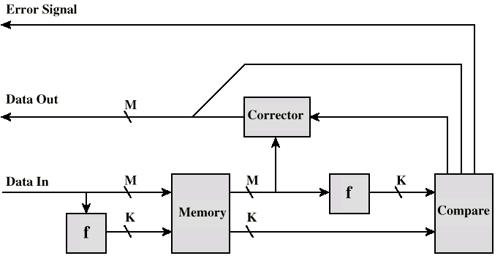
Error Correcting Code Function

Slide 4
Hamming Code
A
B
A
B
1
1
1
0
1
1
1
0
1
0
0
C
C
Assign data bits to the inner compartments.
Fill the remaining compartments with parity bits.
The total number of bits in a circle must be even.
For example: The data bits in A = 1+1+1 = 3. This is odd – therefore add an additional

Slide 5
Hamming Code
A
B
1
1
1
0
C
A
B
A
B
1
1
0
1
1
0
1
1
1
0
0
0
0
0
0
C
C
If a bit gets erroneously changed, the parity bits in that circle will no longer add up to 1.
Errors are found in A and C – and the shared bit in A and C is in error and can be fixed.

Slide 6
Single Bit Errors in 8-bit words
8 data bits
2^{k} – 1 ≥ M + K is used to find the value of K (number of check bits).
No errors => code = 0.
One error bit => error occurred in one of the check bits. No action.
More than one bit set to ‘1’ => the numerical value of the syndrome indicates the position of the data bit in error.
Data bits | Single Error Correction
 | Check Bits | % Increase
8 | 4 | 50
16 | 5 | 31.25
32 | 6 | 18.75
64 | 7 | 10.94
128 | 8 | 6.25
256 | 9 | 3.52

Slide 7
Single Bit Errors in 8-bit words
Data and check bits arranged into a 12-bit word.
Bit positions numbered from 1 to 12.
Bit positions representing position numbers that are powers of 2 are designated as check bits.
Check bits calculated as follows:
Data and check bits arranged into a 12 bit syndrome word:
C1 = D1 D2 D4 D5 D7
C2 = D1 D3 D4 D6 D7
C3 = D2 D3 D4 D8
C4 = D5 D6 D7 D8
8
data bits
4
check bits

Slide 8
Calculating check bits
Bit Position | Binary | Type
1 | 0001 | C1 |  | All D’s with a 1 in bit 1
2 | 0010 | C2 |  | All D’s with a 1 in bit 2
3 | 0011 |  | D1
4 | 0100 | C4 |  | All D’s with a 1 in bit 3
5 | 0101 |  | D2
6 | 0110 |  | D3
7 | 0111 |  | D4
8 | 1000 | C8 |  | All D’s with a 1 in bit 4
9 | 1001 |  | D5
10 | 1010 |  | D6
11 | 1011 |  | D7
12 | 1100 |  | D8
C1 = D1 D2 D4 D5 D7
Each check bit works on every data bit who shares the same bit position

Slide 9
Example
Input word: 00111001
Databit D1 in rightmost position
Calculate check bits:
C1 = 1 ⊕ 0 ⊕ 1 ⊕ 1 ⊕ 0 = 1
C2 = 1 ⊕ 0 ⊕ 1 ⊕ 1 ⊕ 0 = 1
C3 = 0 ⊕ 0 ⊕ 1 ⊕ 0 = 1
C4 = 1 ⊕ 1 ⊕ 0 ⊕ 0 = 0
Stored word = 001101001111
If data bit 3 sustains an error (001101101111)
C1 = 1 ⊕ 0 ⊕ 1 ⊕ 1 ⊕ 0 = 1
C2 = 1 ⊕ 1 ⊕ 1 ⊕ 1 ⊕ 0 = 0
C3 = 0 ⊕ 1 ⊕ 1 ⊕ 0 = 0
C4 = 1 ⊕ 1 ⊕ 0 ⊕ 0 = 0
Calculate syndrome word:
0110 = bit position 6.
D3 resides in bit position 6.
 | C8 | C4 | C2 | C1
 | 0 | 1 | 1 | 1
 | 0 | 0 | 0 | 1
 | 0 | 1 | 1 | 0

Slide 10
Double Error Detecting
Previous example is Single-Error-Correcting code.
Semiconductor memory is usually equipped with SEC-DED (Single-error-correcting, double-error-detecting code. SEC-DED requires an extra bit.
a.
b.
c.
0
0
0
1
1
0
1
1
1
0
1
0
1
0
1
0
1
0
1
0
Fill in data bits.
Calculate check bits.
Two errors are introduced
d.
e.
f.
1
0
1
1
0
1
1
0
1
0
0
0
1
0
1
1
1
1
1
0
1
0
1
0
The extra bit checks for even parity.
The double error is detected!
SEC identifies the wrong bit

Slide 11
Problems
Suppose an 8-bit data word stored in memory is 11000010. Using the Hamming algorithm, determine what check bits would be stored in memory with the data word. Show how you got your answer.
For the 8-bit word 00111001, the check bits stored with it would be 0111. Suppose when the word is read from memory, the check bits are calculated to be 1101. What is the data word that was read from memory?

Slide 12
References
William Stallings “Computer Organization and architecture” Prentice Hall, 7th edition, 2006
Internet: PPT slides, Author: Jane and Harold Huang

